Slide 1
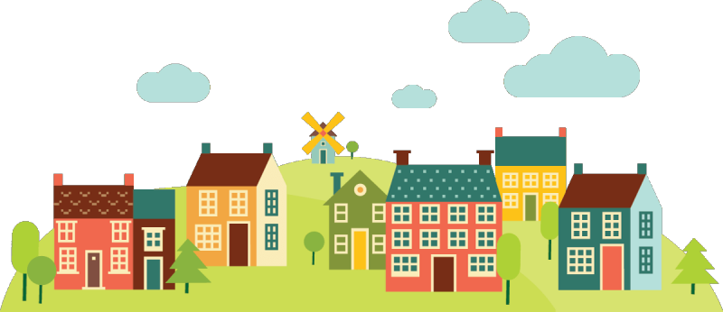




Canby Housing Needs Analysis
June 28, 2022, 6pm

Slide 2

Agenda
Welcome
Project Overview
Outreach Summary
Buildable Land Inventory
Reconciliation of Residential Supply and Demand
Next steps

Slide 3
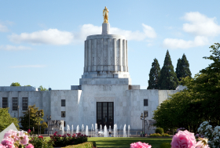
Housing Needs Analysis Overview
OAR 660, ORS 197.296 and divisions 7, 8 & 24 provide a framework for Comp. Plan amendments related to Housing Needs Analysis (HNA):
Housing needs projection
Buildable land inventory (BLI)
Residential land needs analysis
Policy measures for accommodating needed housing
HB 4006 puts new emphasis on addressing severe rent burdens*
* When households spend over 50% of income on gross rent

Slide 4
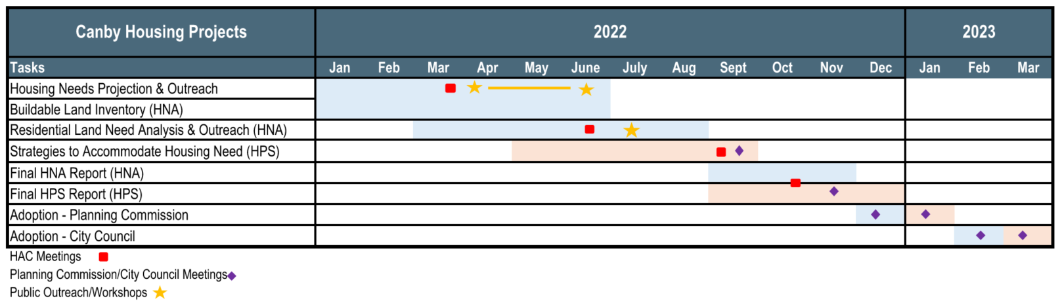
Project Schedule

Slide 5
Outreach Summary

Slide 6
Community Outreach Summary
Housing Producers
Developers
North Willamette Habitat for Humanity
Land use attorney
Apartment complex manager

Slide 7
Community Outreach Summary
Housing Consumers
Hope Village (staff)
Canby Center (staff)
Canby Adult Center (staff)
Canby Adult Center Focus Group
Bridging Cultures

Slide 8
Buildable Land Inventory

Slide 9
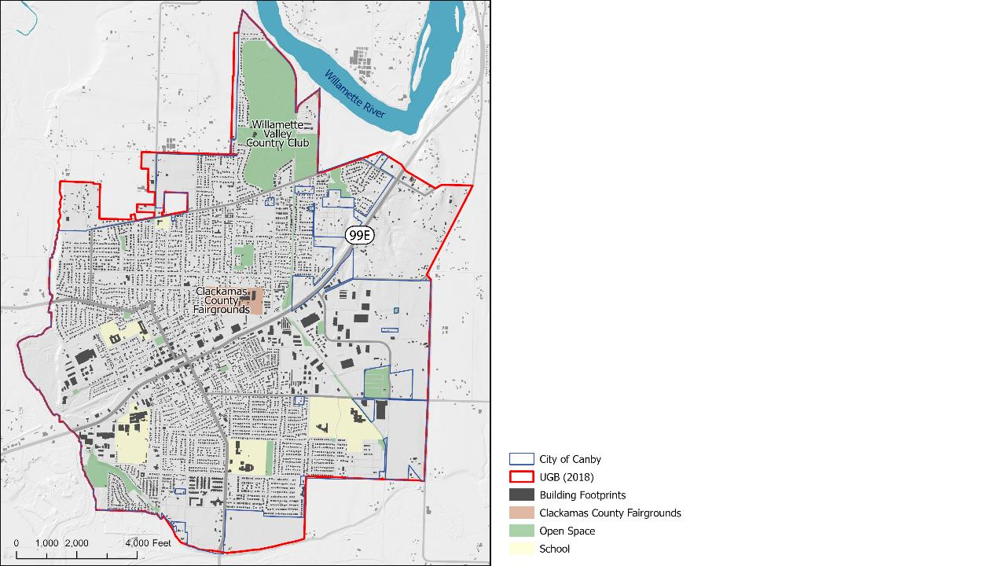
City of Canby
The City of Canby is made up by almost 3,000 acres. Canby’s urban growth boundary adds another 500 acres.

Slide 10
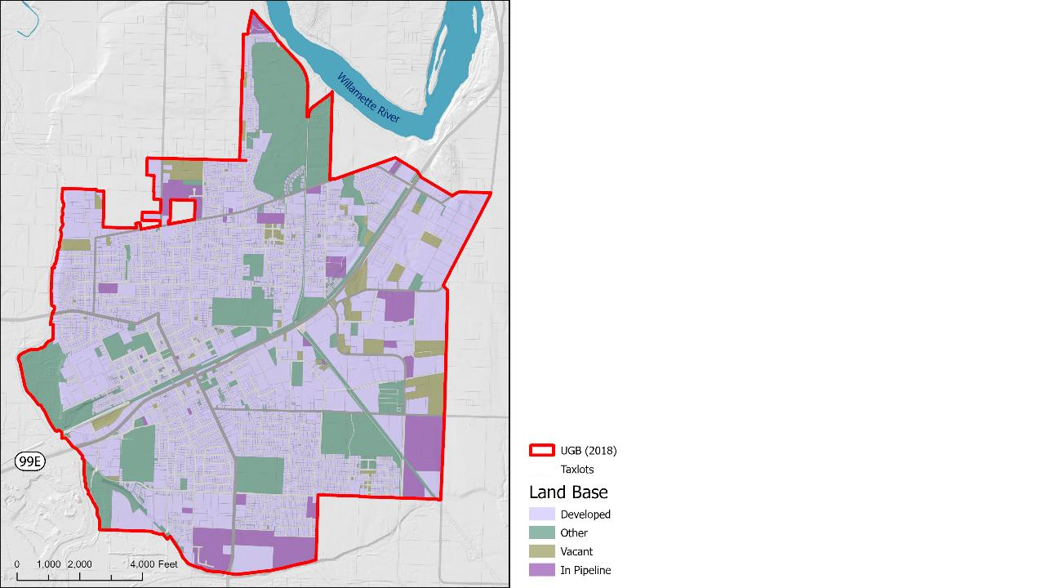
City of Canby
627 additional housing units are approved or under review. Two large senior housing projects are also in the pipeline.

Slide 11
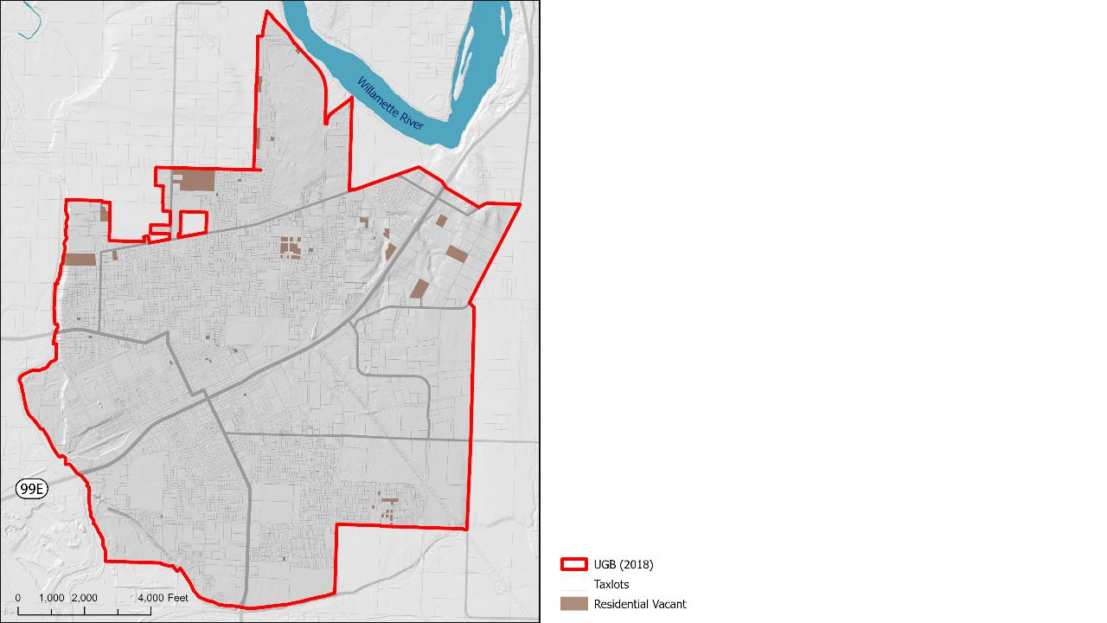
Residential Vacant
A residential lot of at least 3,000 square feet and a building value of less than $10,000 identifies as vacant.
Notes:
660-038-0060
Buildable Lands Inventory (BLI) for Residential Land within the UGB
2) The city must identify all vacant lots and parcels with a residential comprehensive plan designation. A city shall assume that a lot or parcel is vacant if it is at least 3,000 square feet with a real market improvement value of less than $10,000.

Slide 12
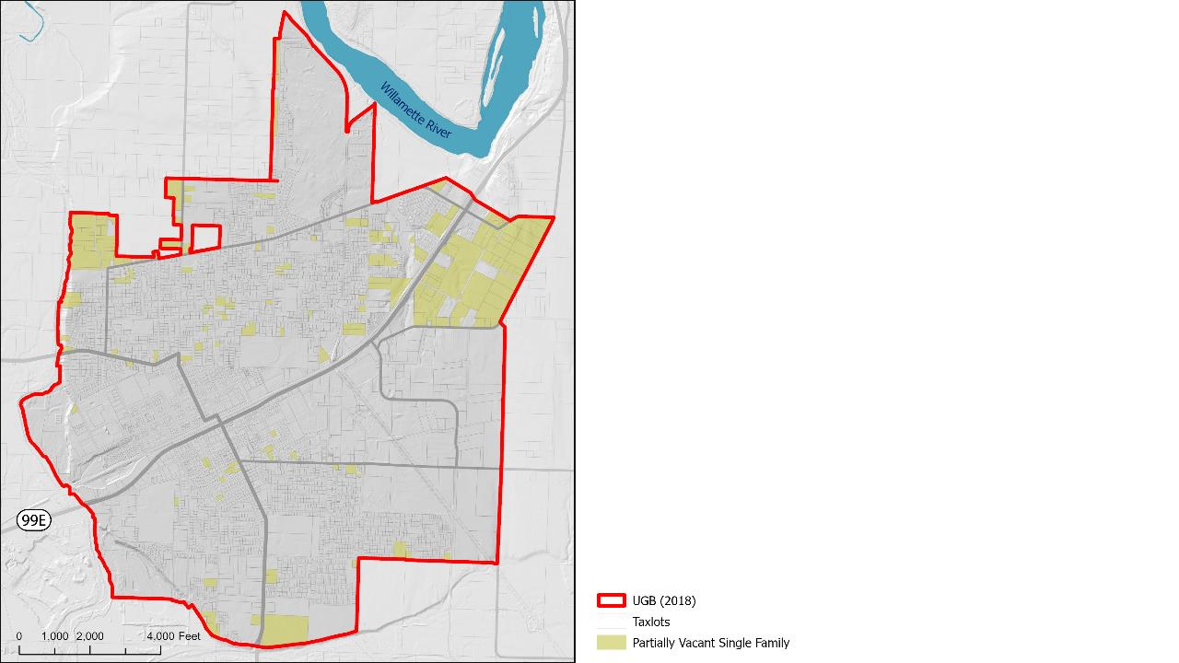
Residential Partial Vacant SF
Single family lots larger than one-half acre are assumed partially vacant. This includes agricultural lands with dwellings that might not be residential but the land itself has a residential designation.
Notes:
660-038-0060
Buildable Lands Inventory (BLI) for Residential Land within the UGB
3(a) For lots and parcels at least one-half acre in size that contain a single-family residence, the city must subtract one-quarter acre for the residence, and count the remainder of the lot or parcel as vacant land, and

Slide 13
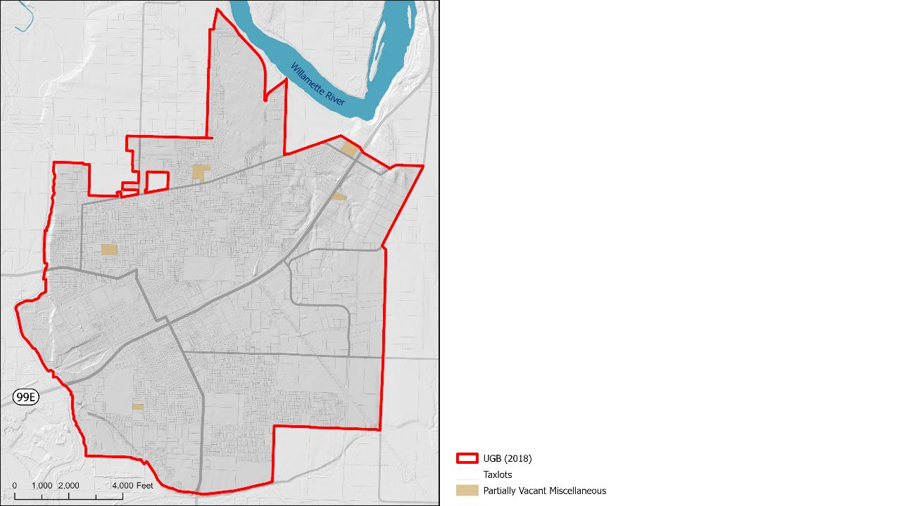
Residential Partial Vacant Misc.
There are multiple sites that might be available for further development that are not currently used residentially.
Most of the tax lots are occupied by religious facilities.
Notes:
660-038-0060
Buildable Lands Inventory (BLI) for Residential Land within the UGB
) For lots and parcels at least one-half acre in size that contain more than one single-family residence, multiple-family residences, non-residential uses, or ancillary uses such as parking areas and recreational facilities, the city must identify vacant areas using an orthophoto or other map of comparable geometric accuracy. For the purposes of this identification, all publicly owned park land shall be considered developed. If the vacant area is at least one-quarter acre, the city shall consider that portion of the lot or parcel to be vacant land.
C) Lots and parcels, or portions of a lot or parcel, which are in use as a non-public institution or facility, including but not limited to private schools and religious institutions. The excluded lots and parcels or portions of lots and parcels may not include vacant or unimproved lands that are owned by the non-public institution or facility.

Slide 14
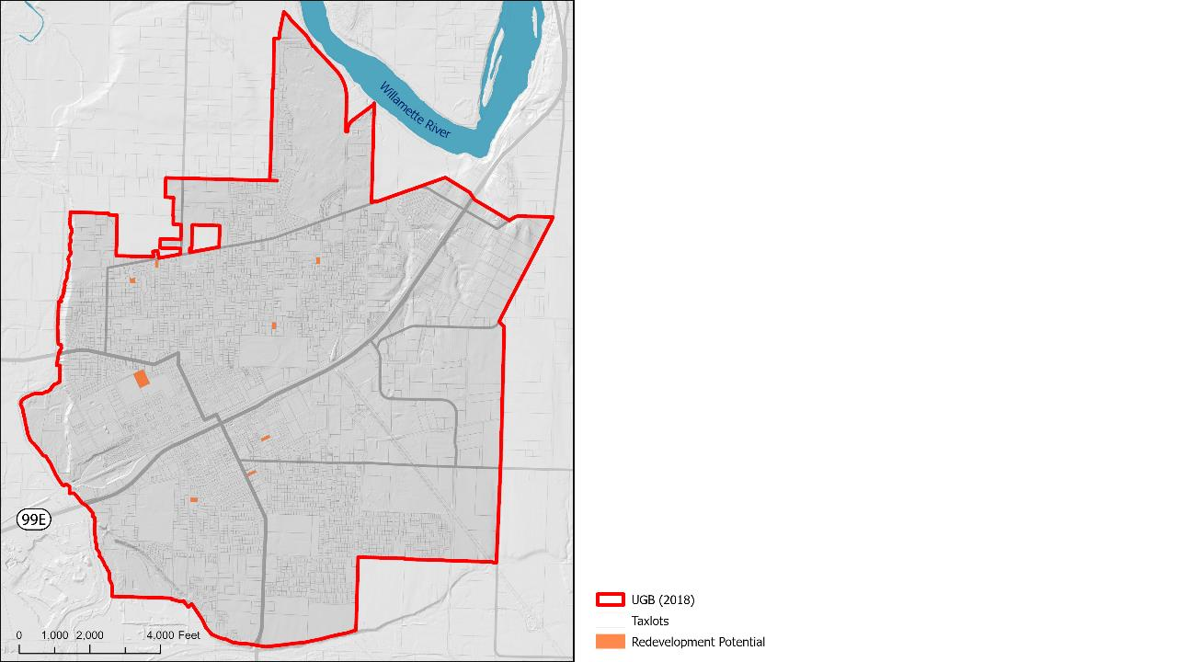
Residential Redevelopment Potential
Sites that have a lower improvement value then land value and are at least 20,000 sq ft.

Slide 15
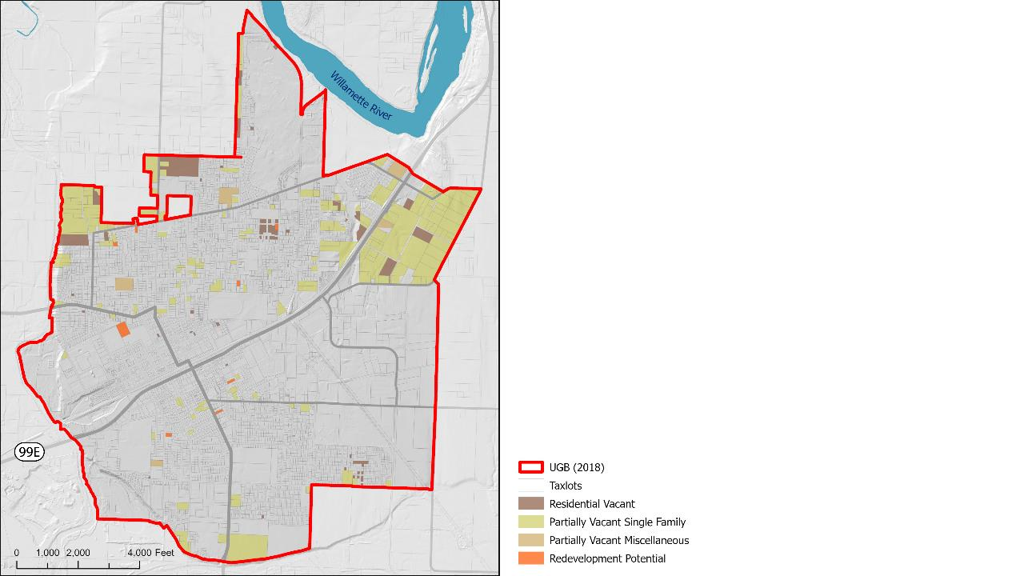
Residential Combined
*Includes Mixed-Use

Slide 16
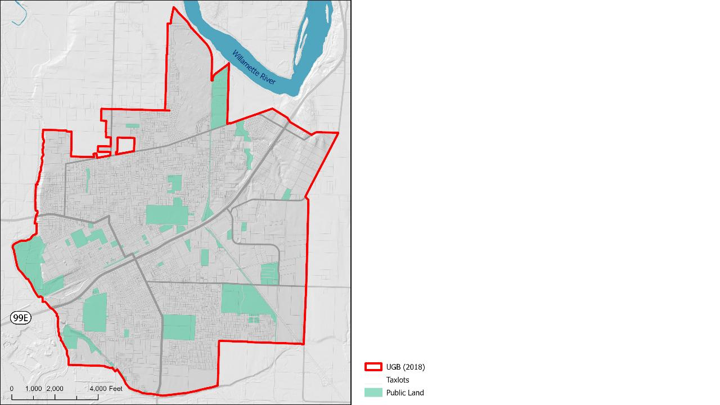
Public Lands
Land with public ownership is excluded from future development.

Slide 17
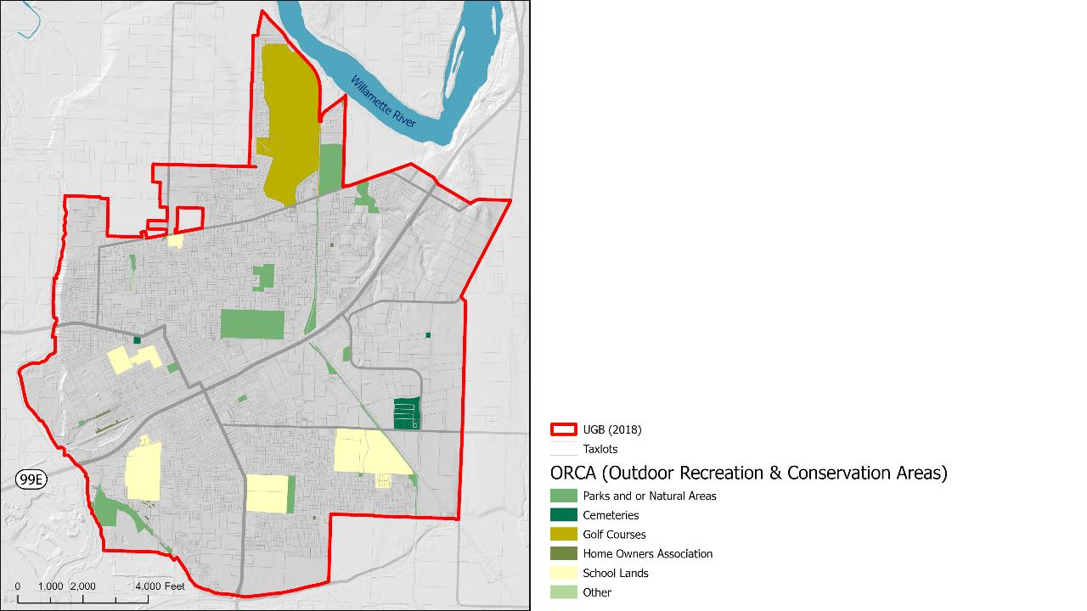
Parks and Open Spaces
Parks and other open spaces are excluded from future development.

Slide 18
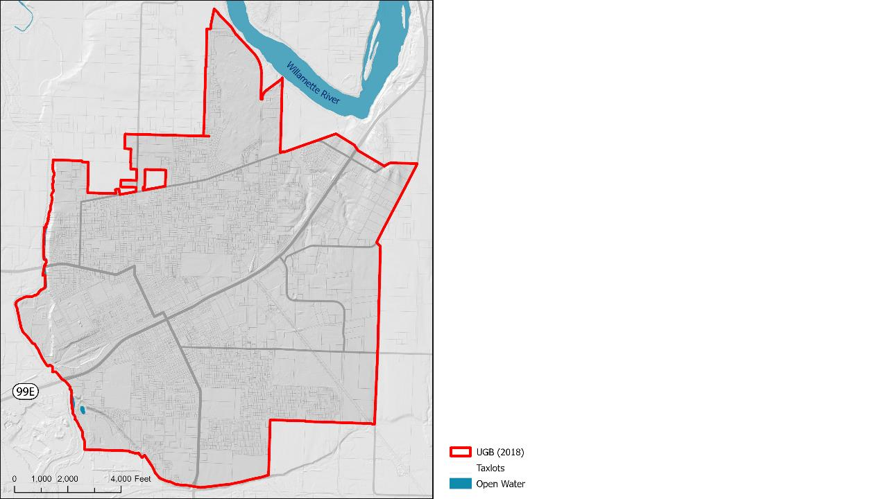
Open Water
“…Lakes, ponds, sloughs, and coastal waters at least one-half acre in size.”

Slide 19
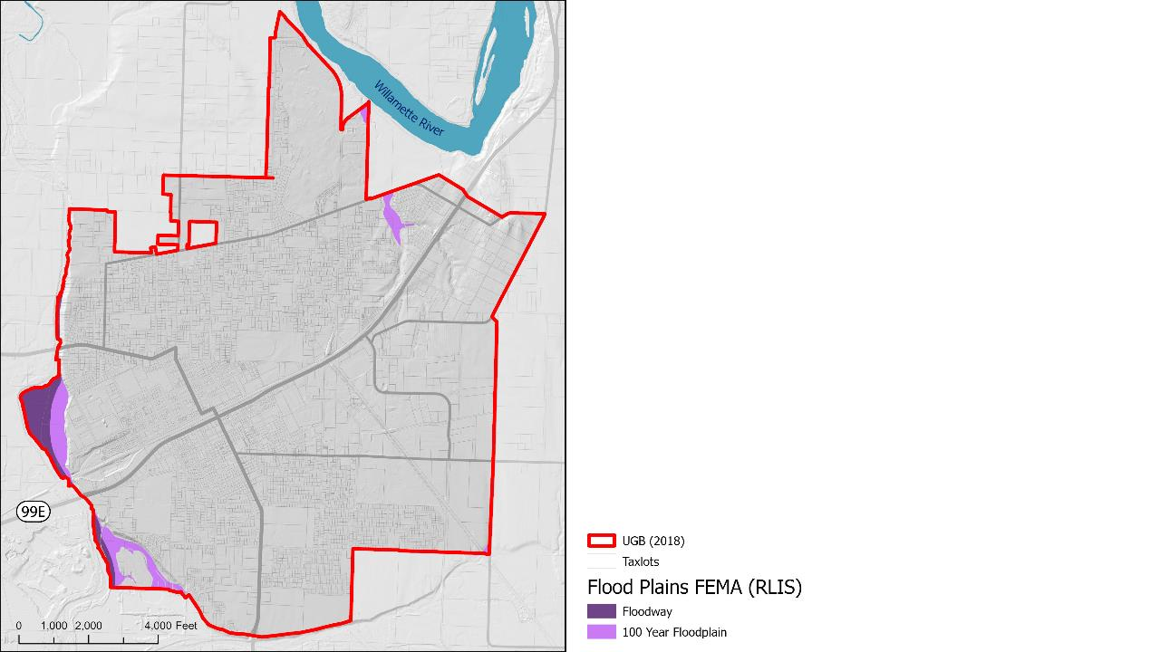
Flooding
Floodways and floodplains are excluded for future development.

Slide 20
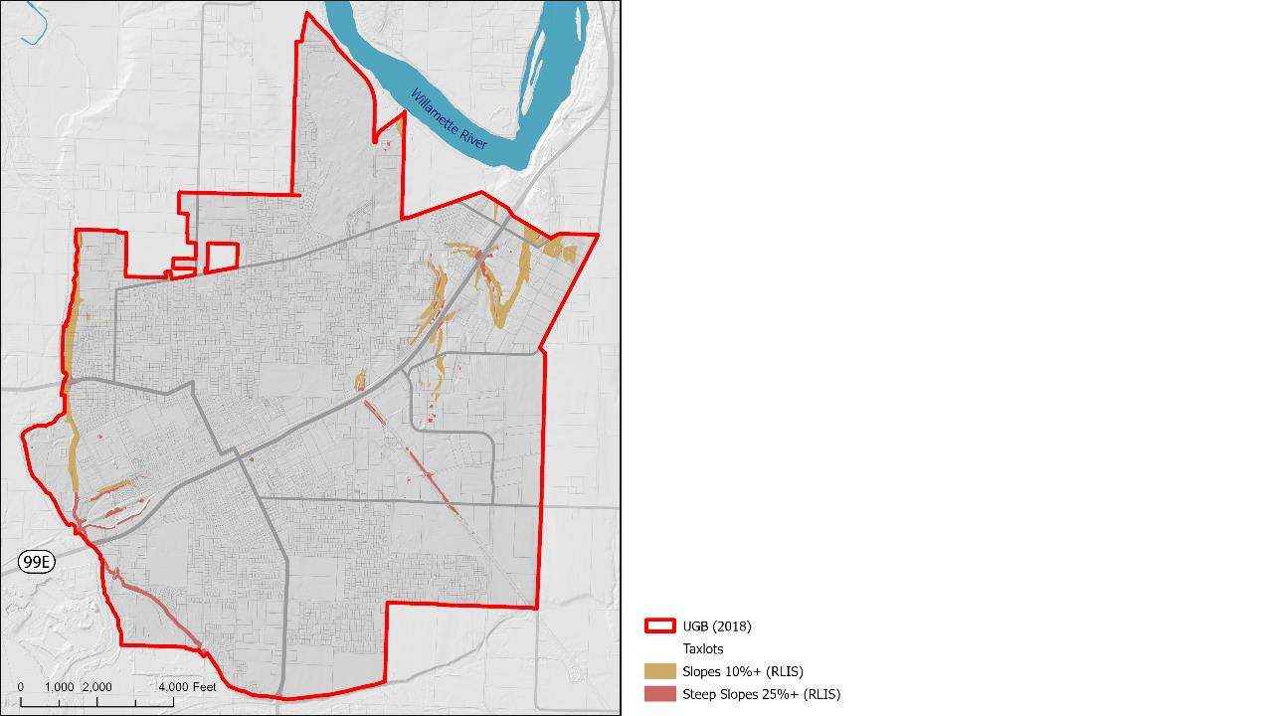
Slopes
Residential development is allowed for areas with slopes less than 25%.

Slide 21
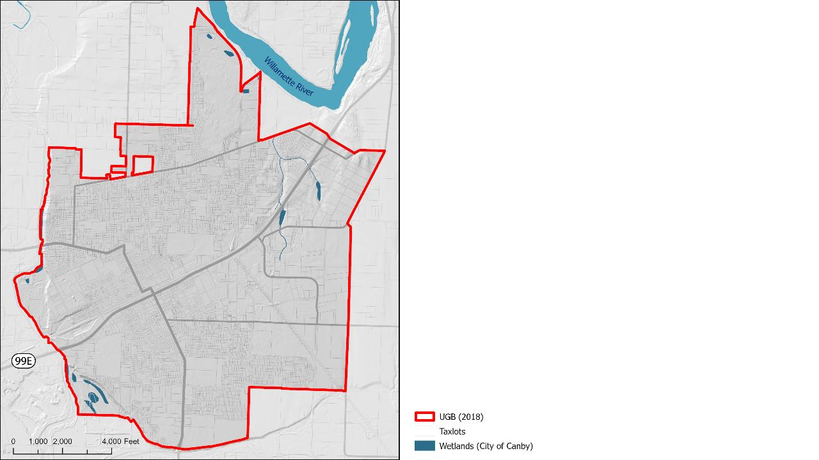
Wetlands
Wetlands can be excluded because Canby’s Comprehensive Plan includes a discussion of wetlands under natural features.

Slide 22
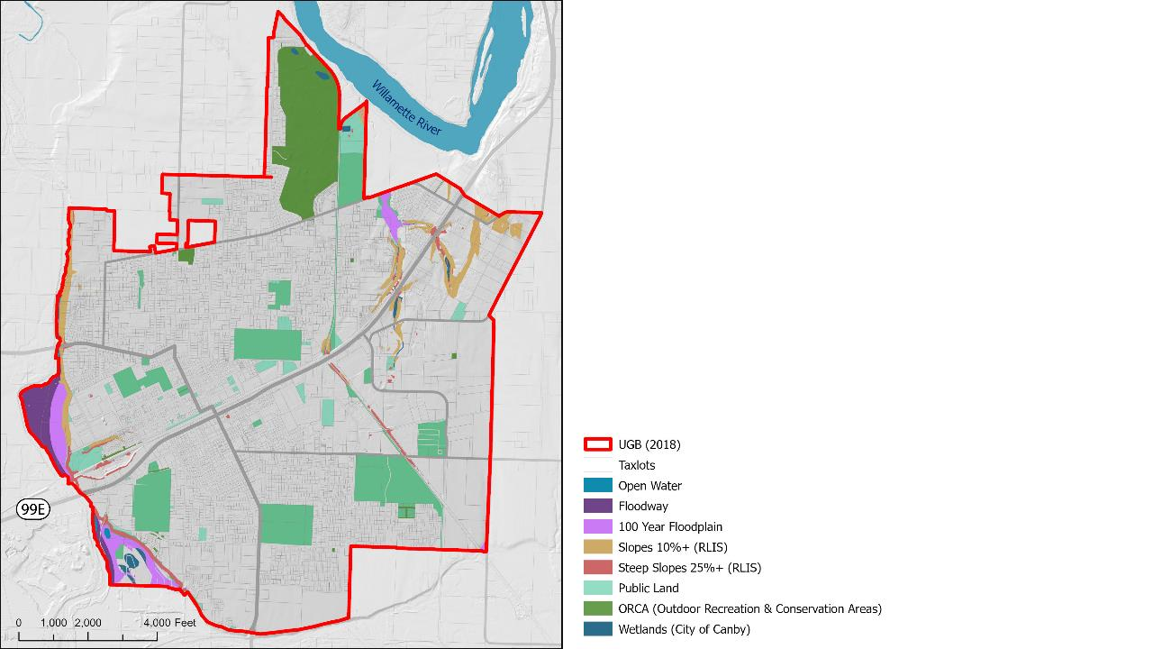
Development Restrictions

Slide 23
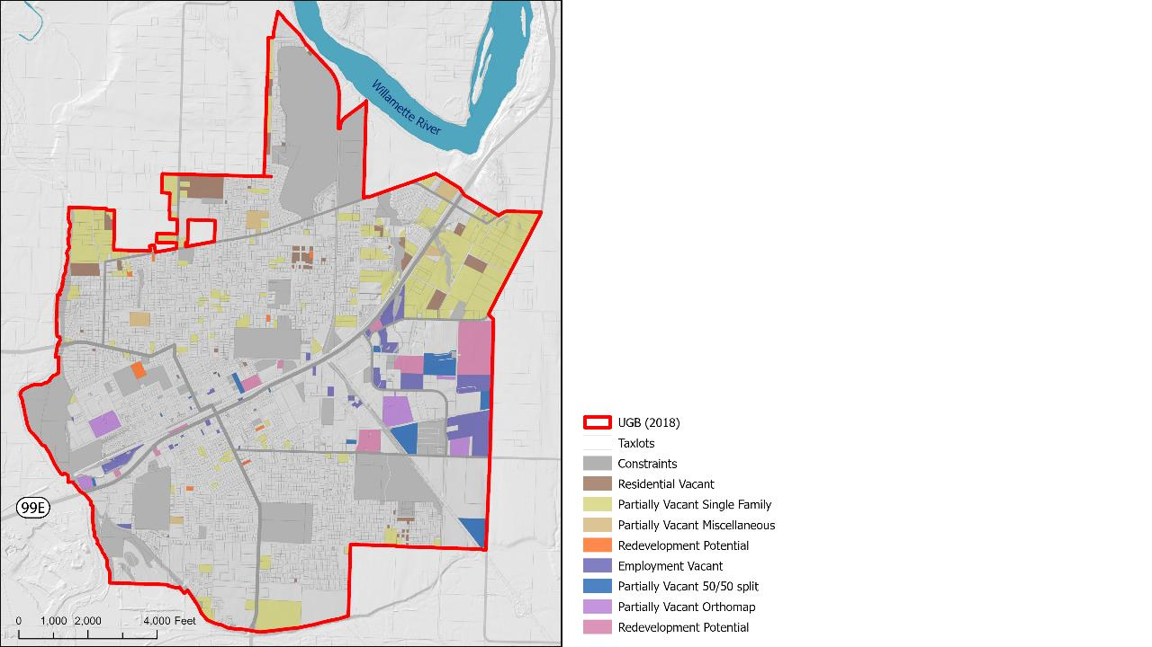
Buildable Land
*Combines residential and employment Redevelopment Potential

Slide 24
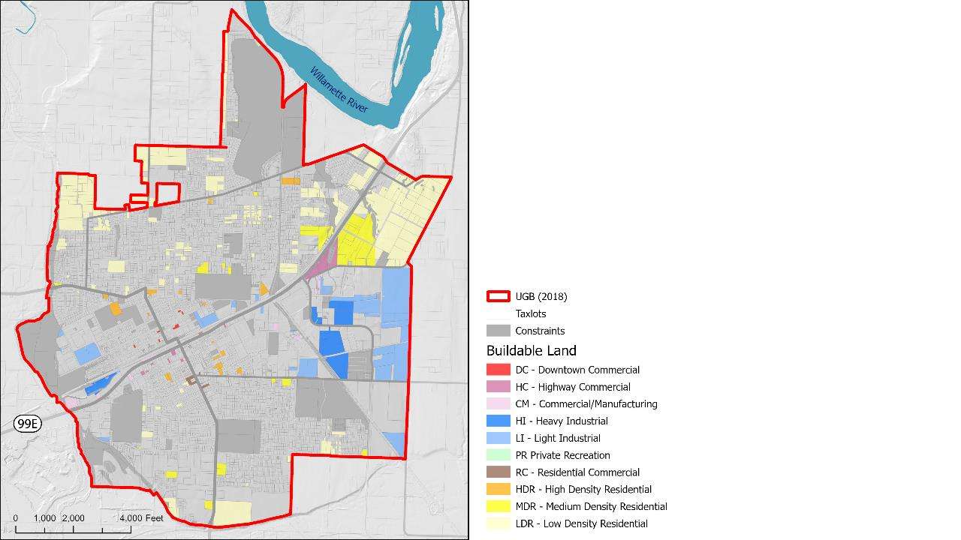
Buildable Land

Slide 25
Draft Reconciliation of
Residential Land Supply and Demand

Slide 26
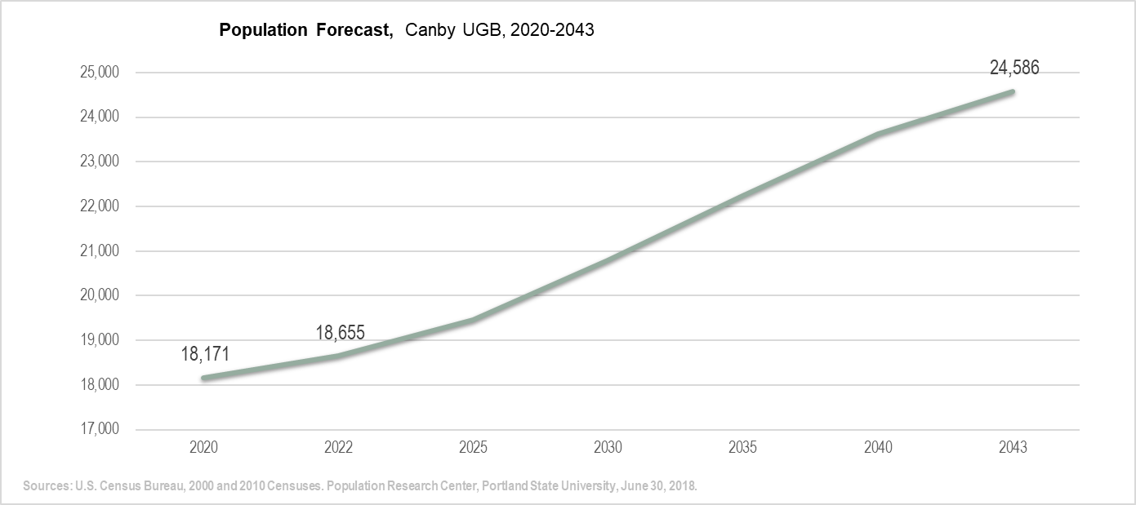
Population Growth Forecast
Canby UGB is projected to add +/-5,931 people over next 20 years
Household growth exceeds population growth rate as household size shrinks

Slide 27
Projected Housing Needs
Canby is projected to need 2,235 units by 2043.

Slide 28
Projected Residential Land Need

Slide 29
Vacant Land Area by Plan Designation

Slide 30
Residential Land Sufficiency
Canby has a UGB deficit of approx. 146.5 acres to meet the 20-year residential land need.

Slide 31
Next Steps

Slide 32
Project Schedule
Public Meeting – July 14th

Slide 33
Thank You
June 28, 6pm

