Slide 1



Economic Opportunities Analysis
Advisory Committee Meeting
June 9, 2022
Todd Chase, AICP, LEED
Tim Wood

Slide 2
Agenda
Economic Opportunities Analysis (EOA) Methodology
Buildable Land Inventory Findings
Economic Trends
Target Industries Discussion
Site Suitability Discussion
Next Steps

Slide 3

EOA Overview
Canby’s vision for strengthening economy through economic policies that include community development objectives related to:
Urban land requirements (land needs) for 20-year employment growth forecasts.
Buildable Land Inventory.
Equity & Inclusion: Priority Populations
Community Participation
Policy Goals and Objectives
OAR 660-009
EOA Policy Update

Slide 4
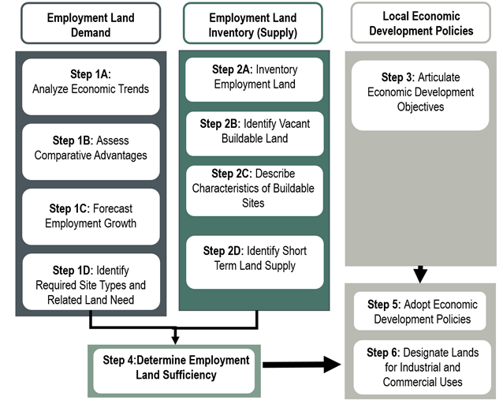
Canby EOA Methodology

Slide 5
Land Base for EOA
Under Review

Slide 6
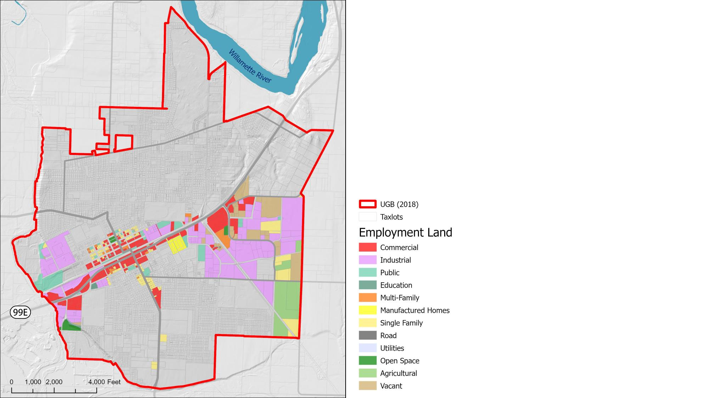
Employment Land
Employment land is made up by commercial and industrial zoning and plan designations including residential commercial.

Slide 7
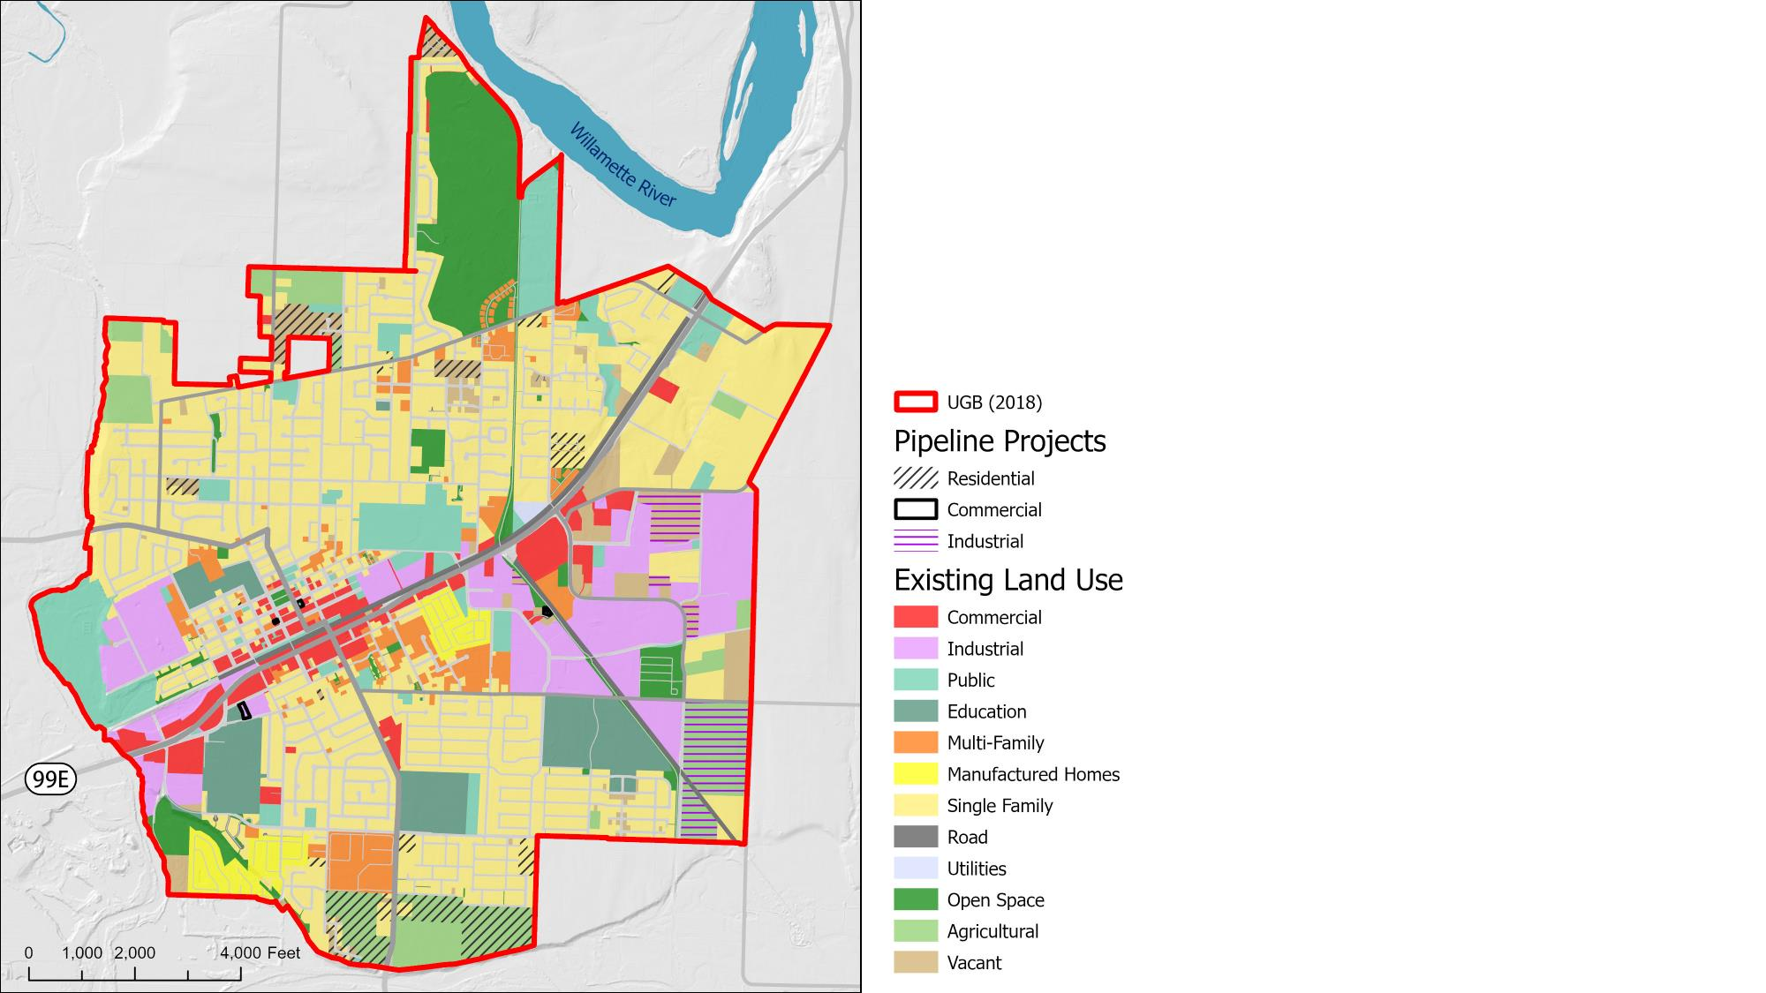
Current Projects
Industrial development ranges from warehousing/distribution to manufacturing.

Slide 8
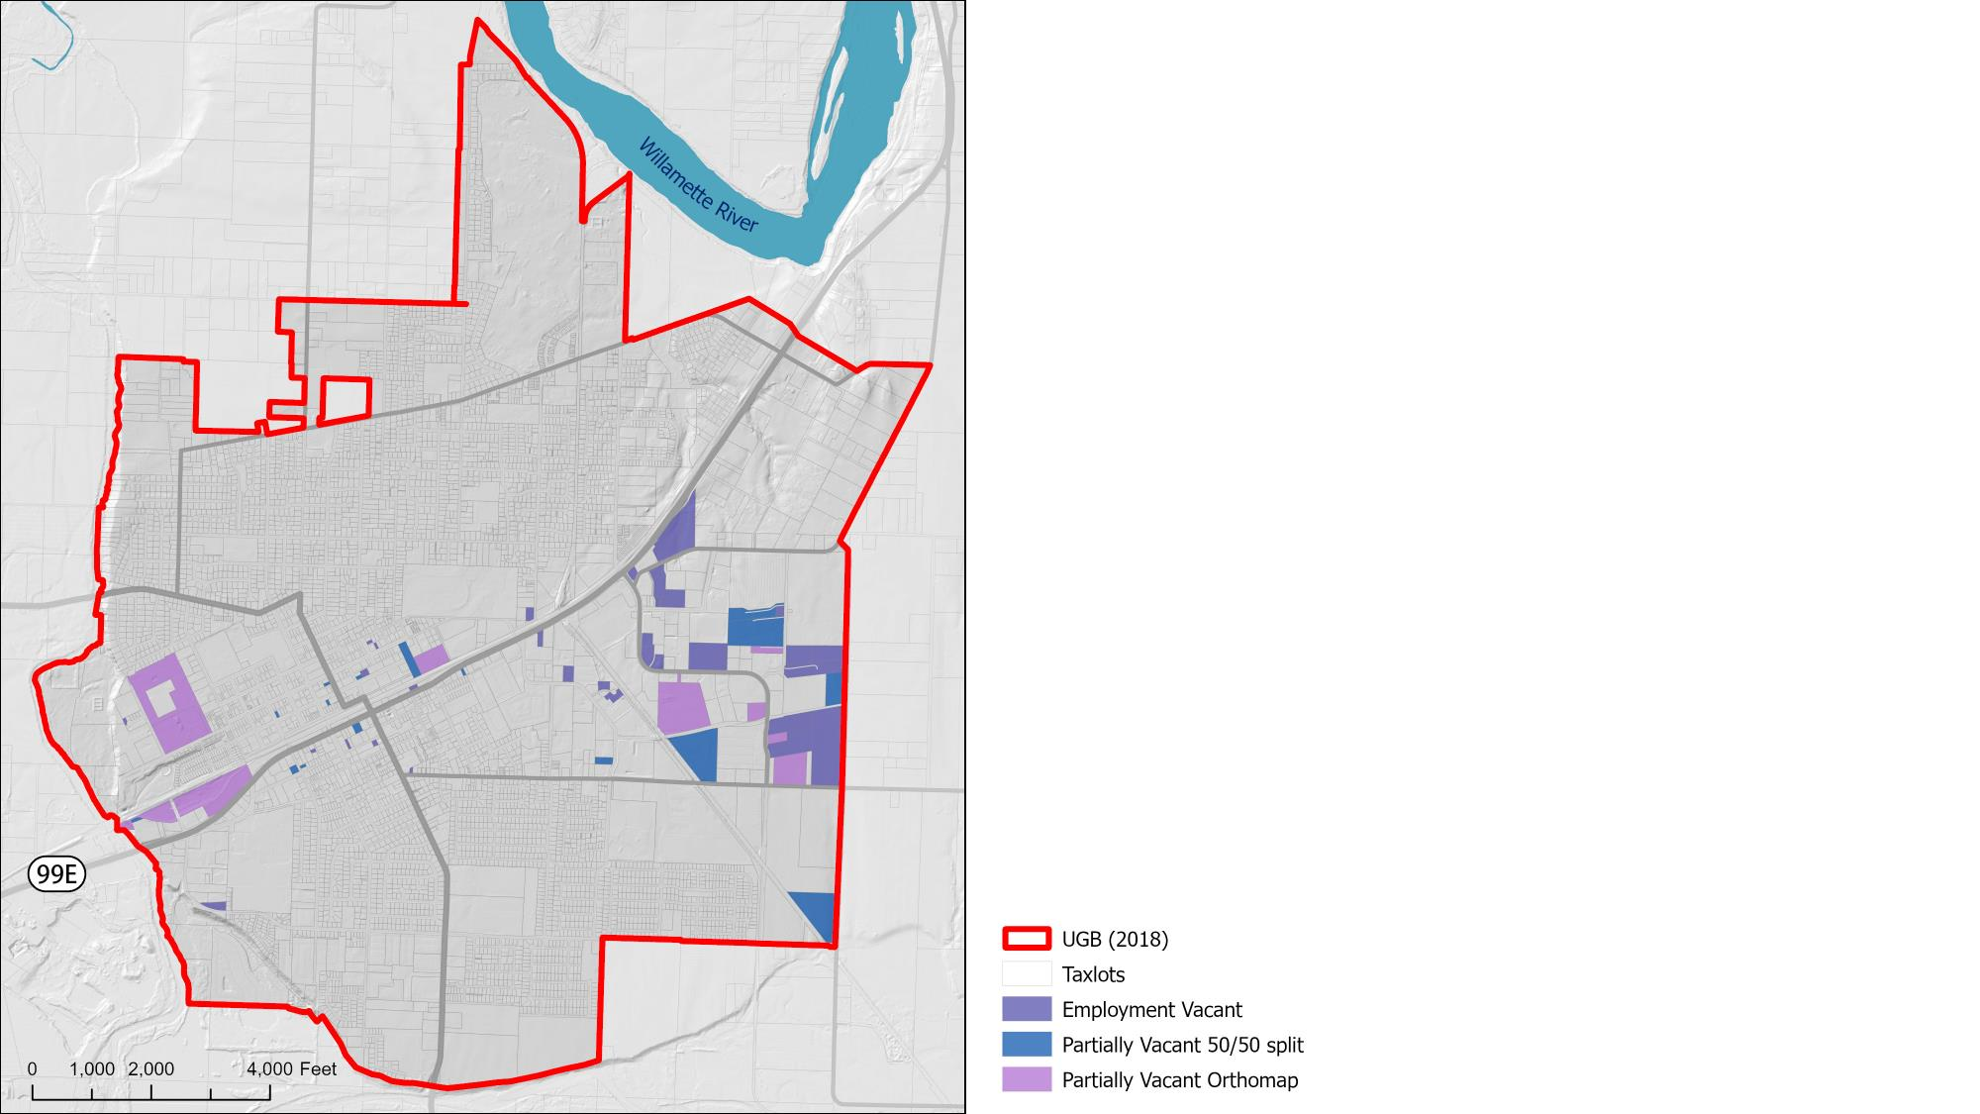
Employment Vacant Combined
Canby has 175 acres spread among 69 vacant lots: 20 lots that are assumed half vacant, and 17 lots with at least one-half acre of unimproved land.
Only 1 lot over 10 acres and 2 lots with 5-9 acres are vacant
DRAFT

Slide 9
Trends Analysis
Discussion

Slide 10
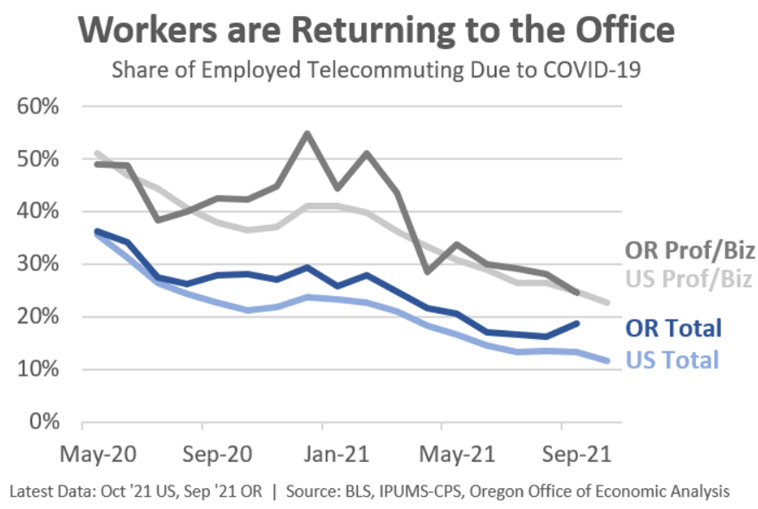
Regional Dynamics
Workforce Trends
Aging population
Working from home
Labor force participation dropping
Migration from cities to burbs
Zoom Cities
Housing costs / availability
Income not keeping up with inflation

Slide 11
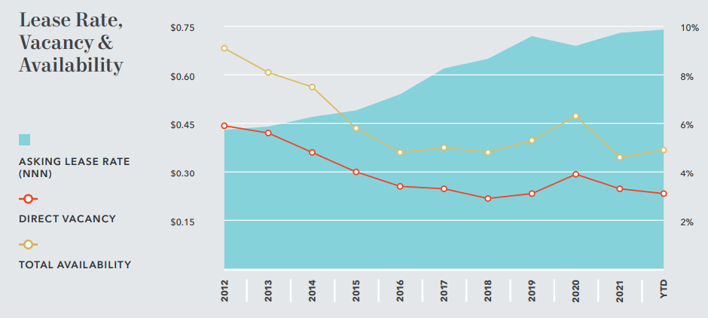
Regional Dynamics
Market Trends
Industrial Activity: Portland Region
Vacancy dropping for industrial and multifamily
Retail and office vacancies still high, but not in Canby
Employment growth heading south and north of Portland
Health care, energy, food processing, distribution sectors adding jobs
Very low unemployment
Trade Leakage from Canby for eating/drinking could support more restaurants

Slide 12
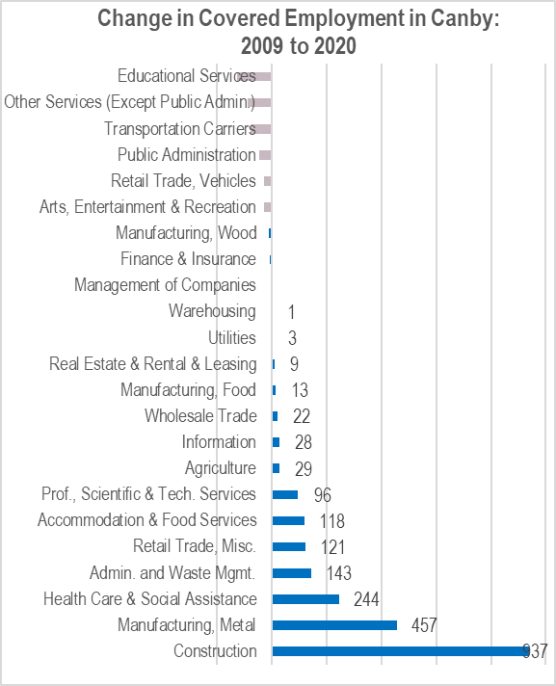
Canby Trends
Most Job Growth occurring on industrial lands
Fast growing sectors: construction, manufacturing, health care, waste management, retail, food services and tech. services

Slide 13
Canby Trends
Mix of small, medium and large employers
Concentrations: energy, high tech, metals, construction, warehousing, food processing
Most growth in small to medium size businesses
Major Private Businesses

Slide 14
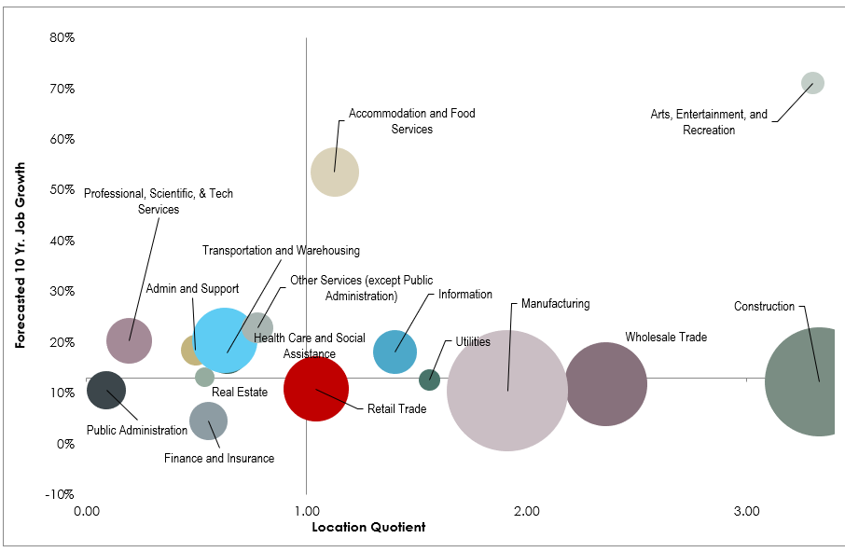
Canby’s Job Clusters
High LQ and Growing
Low LQ and Slowing

Slide 15
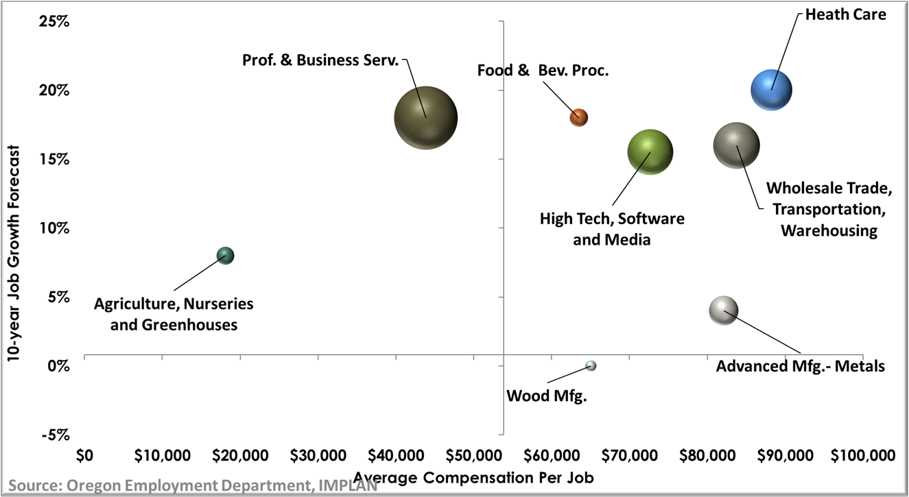
Clusters with Highest Wages
High Wage and Growing
Low Wage and Slowing

Slide 16
Targeted Industries Discussion

Slide 17
Canby Employment Land Needs
Canby can expect to add between 3,355 and 7,237 jobs over next 20 years
Most growth in small to medium size businesses
Employment land needs range from 222 to 522 acres
Land Need

Slide 18
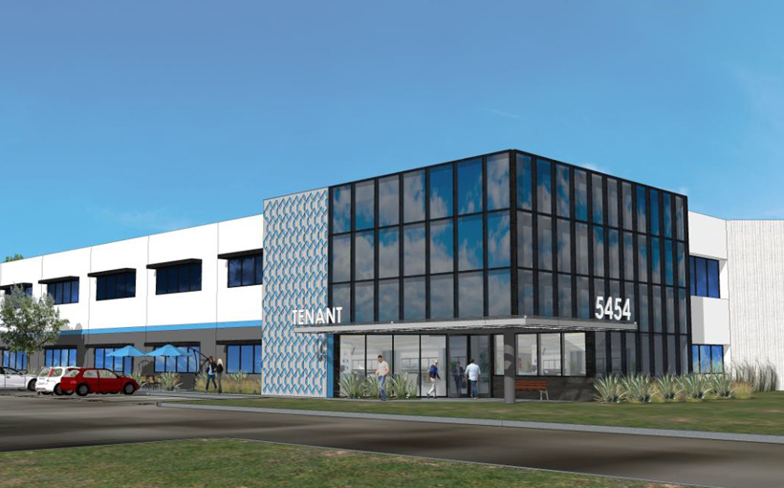

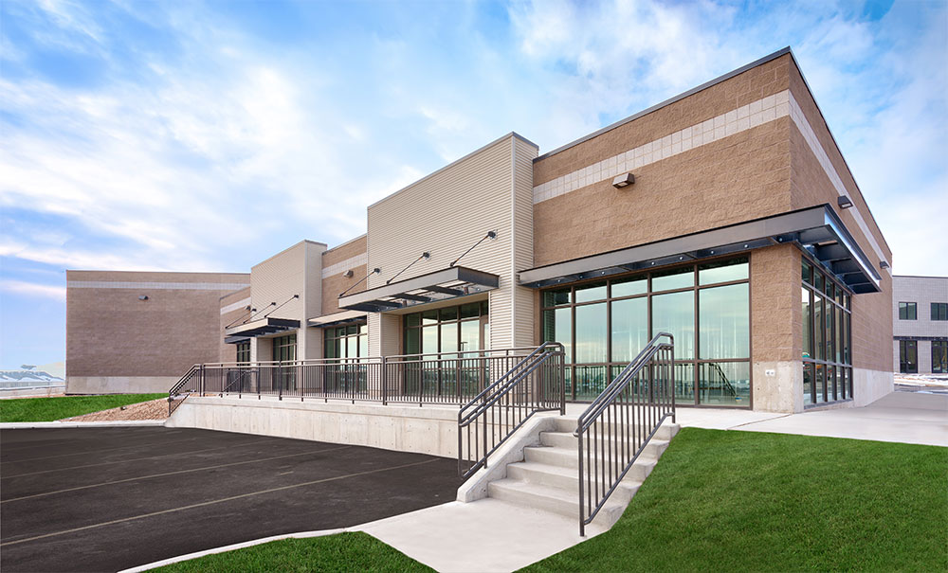
Site Size Requirements

Slide 19
Next Steps

Slide 20
Discussion

Slide 21
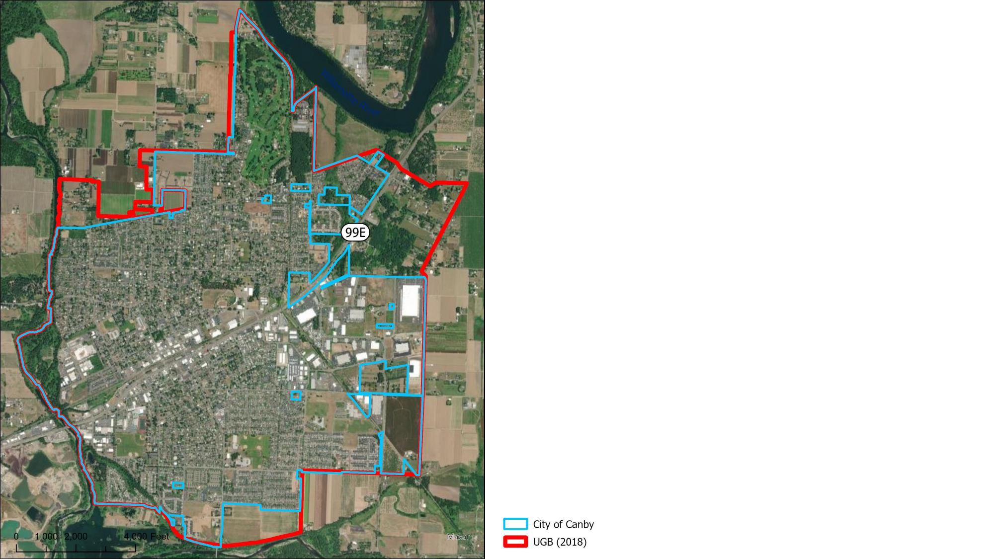
Canby UGB
The City of Canby is made up by almost 3,000 acres. Canby’s urban growth boundary adds another 500 acres. Large swaths of lands are currently unbuilt or under construction.

