Slide 1


Canby UGB Expansion
City Council Hearing
September 16, 2026

Slide 2
Staff Report Findings
Proposed UGB Recommendation is Consistent with:
Adopted Canby Sequential Urban Growth Boundary Process
Adopted 2024 Housing Needs Analysis and 2023 Economic Opportunities Analysis to accommodate 20-year projected housing, employment and park lands
Oregon Statewide Planning Goals
2026 Comprehensive Plan Goals and Policies, including Goal 14 Urbanization
Clackamas County Comprehensive Plan Goals
State Rules and Statues (OAR 660-024-0065 and 0067 and related statutes)

Slide 3
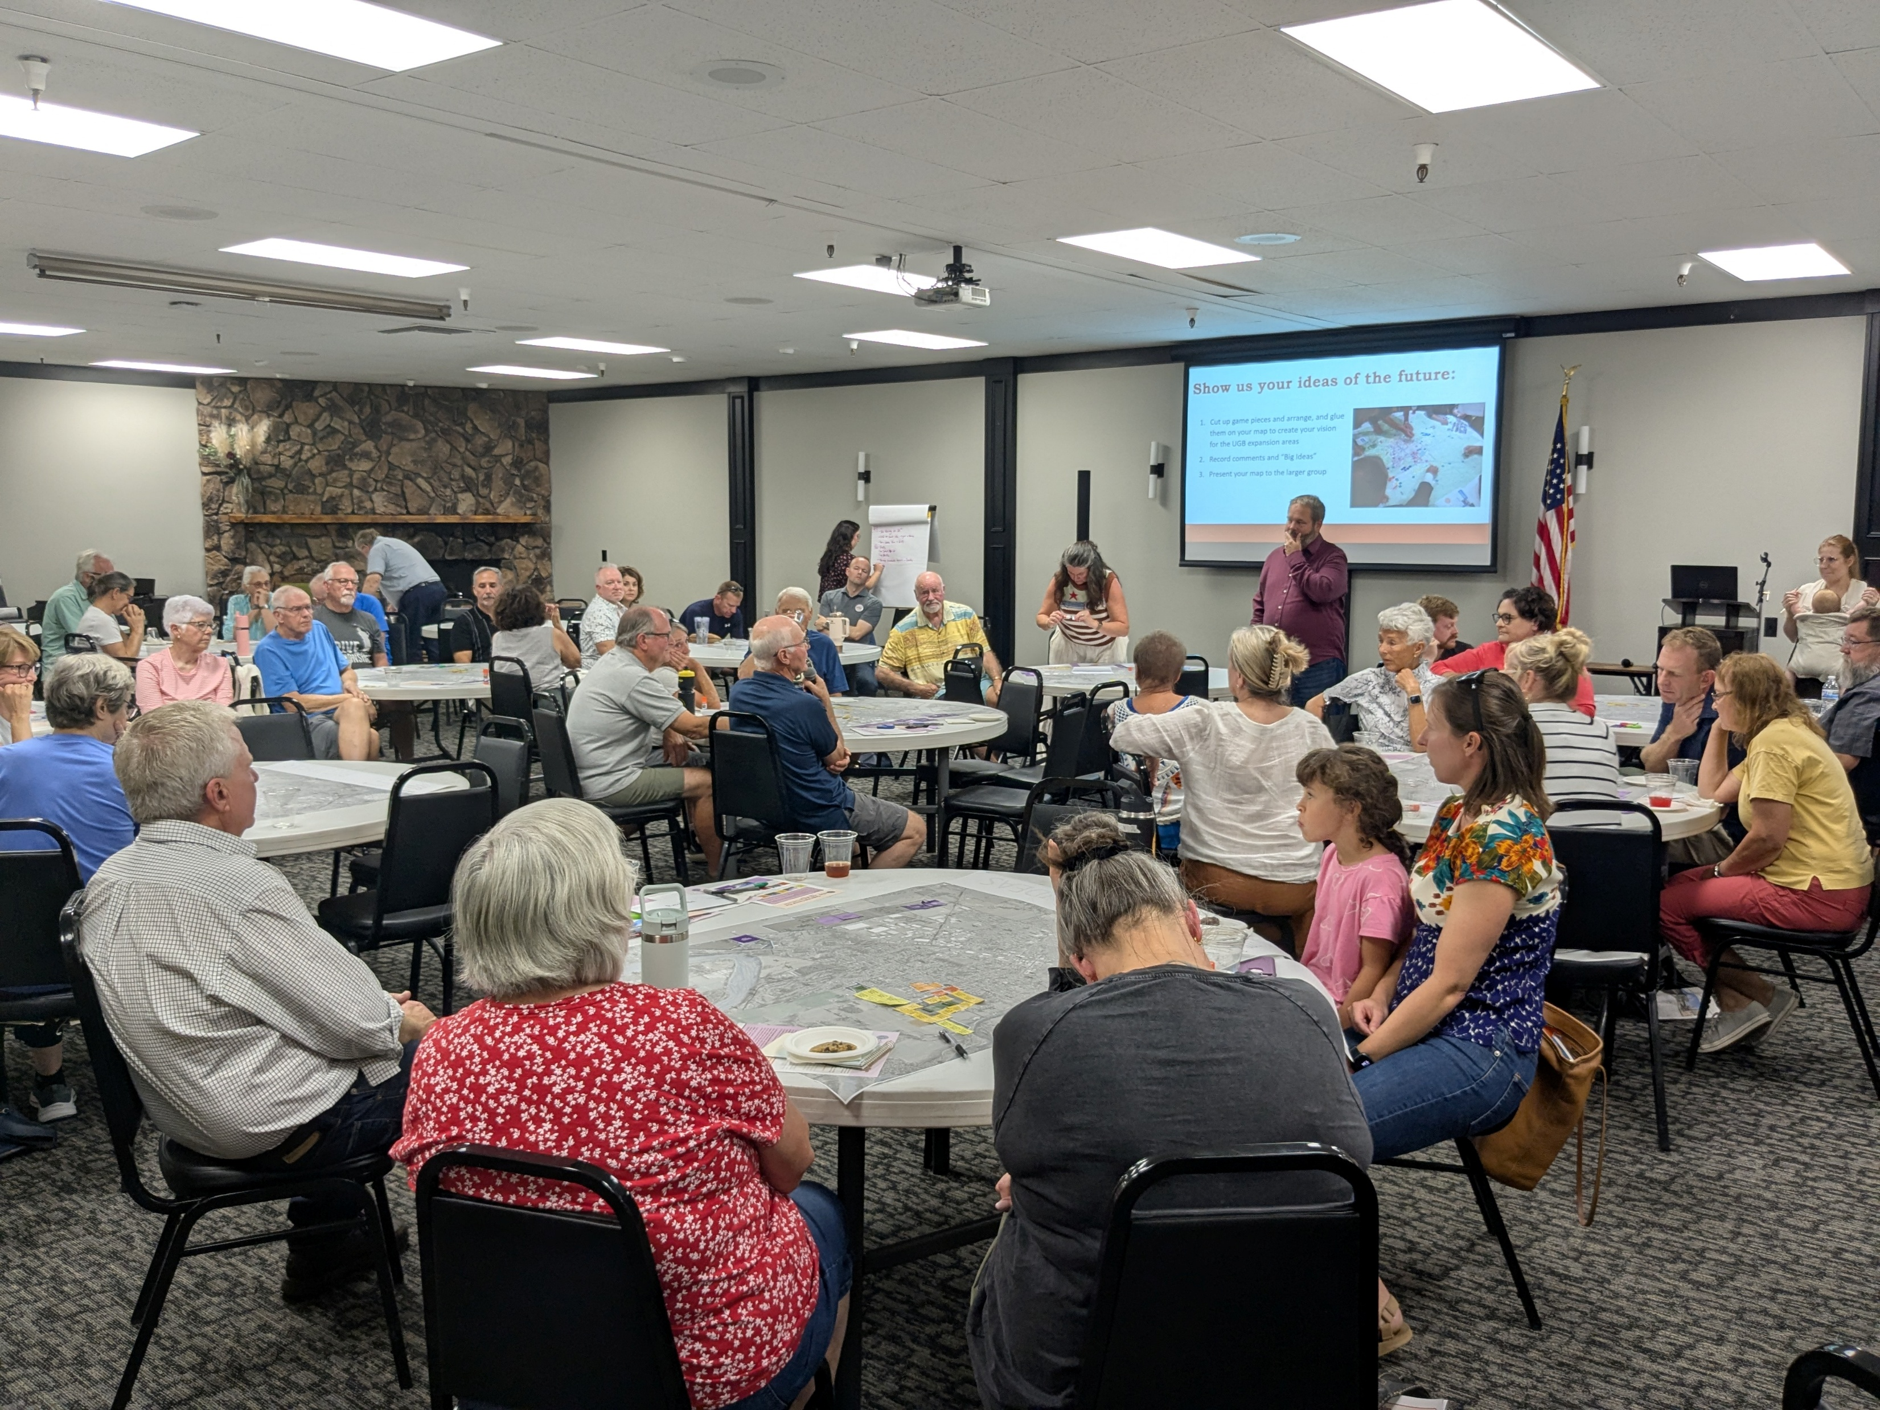
Staff Report Findings
Significant Community Involvement:
Over three years of public engagement activities.
Public meetings, workshops, open houses, tabling at public events, a robust notification program, and online engagement tools.
Materials and meetings catering to the Spanish-speaking community.
Interactive mapping exercises where members of the community expressed their preferences and ideas related to land use patterns, community character, circulation, recreation, and other topics.
Overseen by a Project Advisory Committee (PAC) comprised of elected and appointed officials, community leaders, business owners, and other stakeholders.

Slide 4
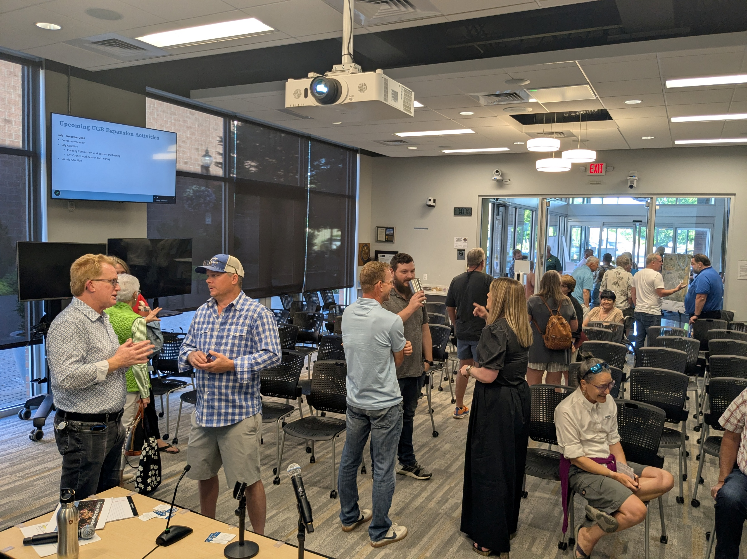
Staff Report Findings
Property Owner Listening Sessions
Three listening sessions with property owners in the UGB Study Area
November 2023 to introduce the Preliminary Study Area and describe the UGB expansion process
June 2024 to present the Study Area, analysis, and prioritization process
June 2026 to present the UGB expansion recommendation

Slide 5
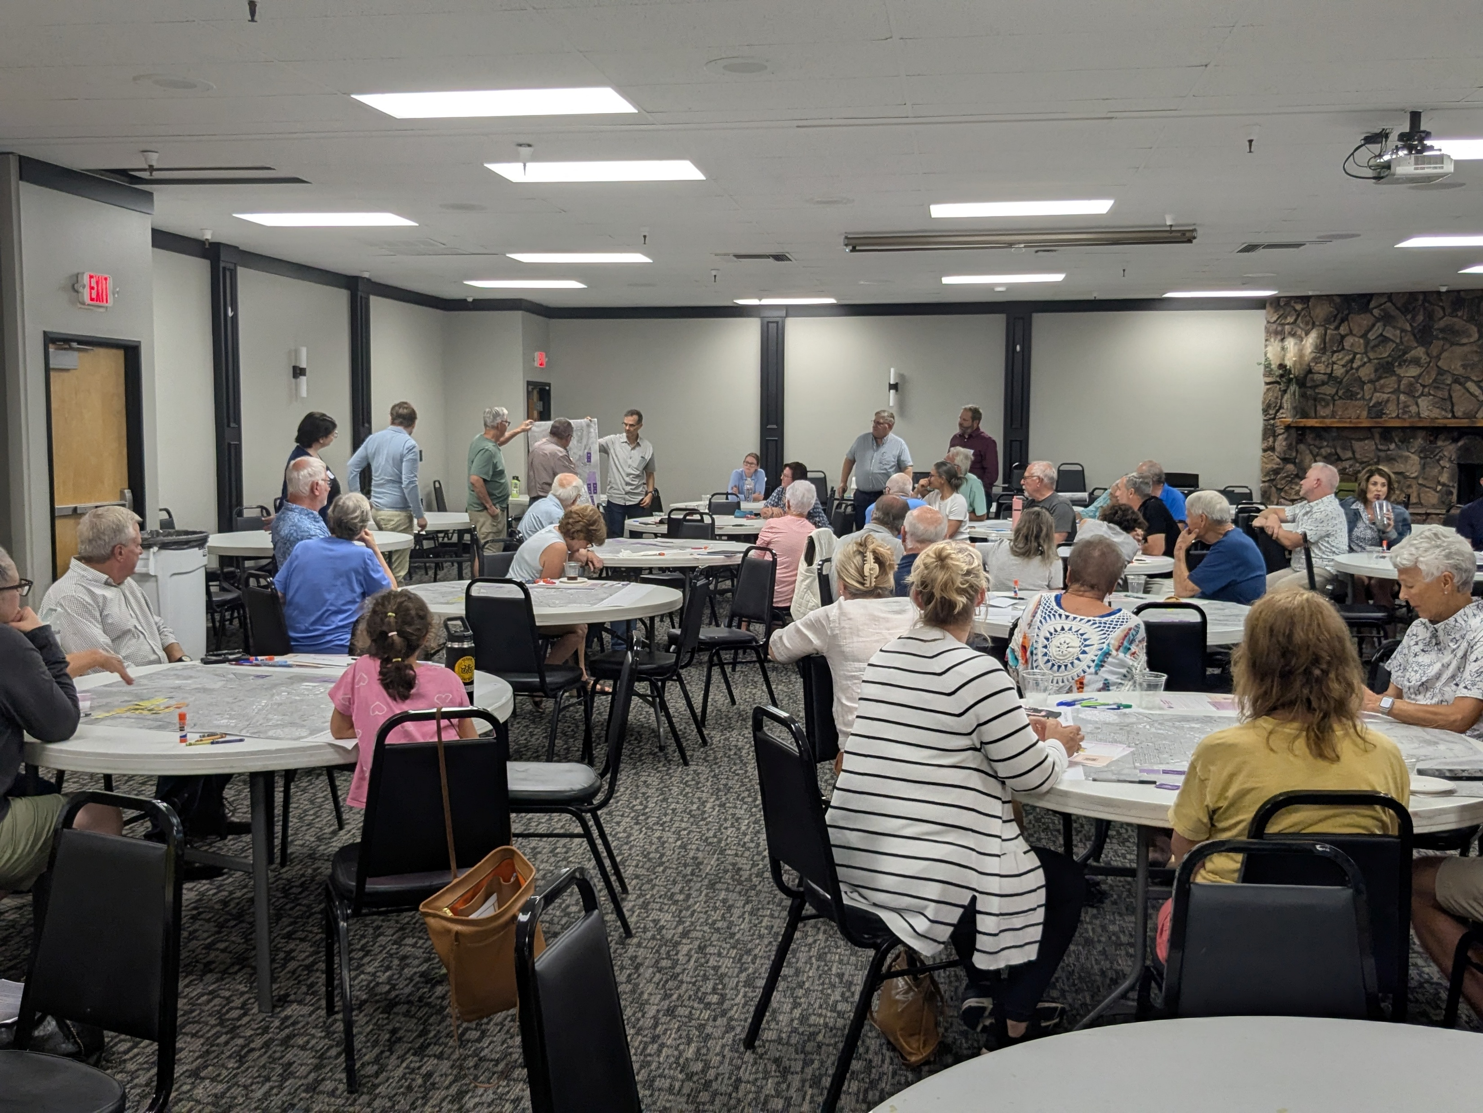

Staff Report Findings
Significant Community and Partner Involvement:
Recommendation provided to the community, planning commission, and city council for review and comments as part of the UGB process and recommendations
DLCD and Clackamas County staff have reviewed and provided comment on the UGB Expansion Report

Slide 6
UGB Amendment Adoption Schedule
Oregon Department of Justice ruled that Canby must adopt a UGB amendment by December 31, 2026, before new OHNA rules go into effect
Failure to adopt a UGB amendment will require updating information under the new rules
November – December 2026
County Planning Commission Hearing – November 9
BOCC Hearing – December 1

Slide 7
UGB Expansion Process and Report

Slide 8
Final Land Need
Land Use | Land Need
Residential *Housing and infrastructure Parks | 98.8 acres 73.1 acres 25.7 acres
Employment (primarily industrial; 0.70 acres commercial) | 439.2 acres
Total UGB Expansion Land Need | Up to 538.0 acres
*Mandatory to accommodate entire residential need.

Slide 9
UGB Expansion Notes
Properties included in the UGB expansion are not required to annex into the city or develop the property and they will not see a change in property taxes. A change in property taxes will occur if and when the property is annexed into the city.
UGB amendment process expands the boundary, but does not assign land uses. Land uses will be assigned through the Canby UGB Concept Plan process. However, it is necessary to discuss land uses when determining where to expand the UGB.
Through community discussion, the City has determined that the Northwest Subareas (1a, 1d, 2, 3, 4, 5, 6) are only appropriate for residential use. The East Subareas are only appropriate for employment use. Several subareas are appropriate for either use (1b, 1c, 7, 10).

Slide 10
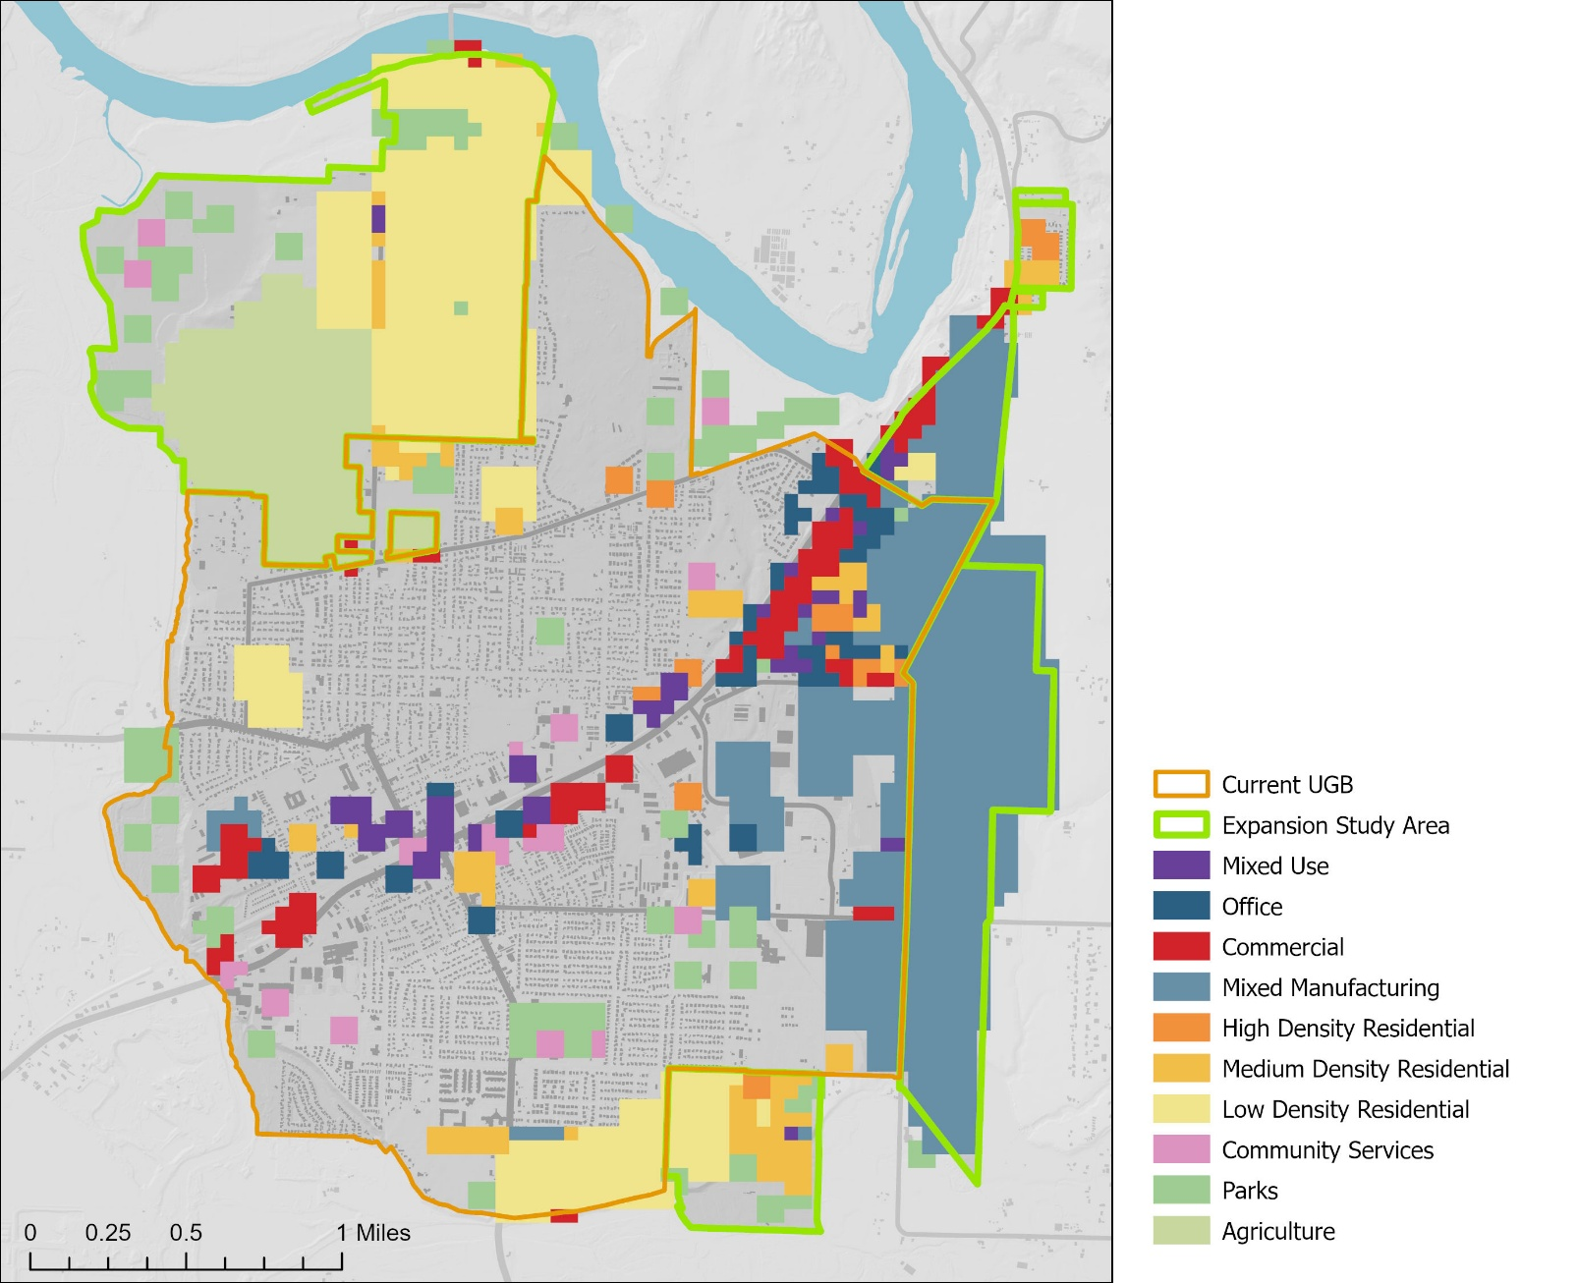
UGB Expansion
Community Preferences
Community members generally prefer residential uses in the northwest subareas and employment uses in the eastern subareas.

Slide 11
Parcel Prioritization
Priority | Applicability to Canby
1. Urban reserves, exception lands, non-resource lands | Canby has no urban reserves or applicable non-resource lands. Canby does have exception lands*.
2. Marginal lands | Canby has no marginal lands.
3. Low Value Farmland | Canby has very little low-value farmland within the UGB Study Area.
4. High Value Farmland | Land within the Canby UGB Study Area is predominantly high-value farmland.
*Exception lands are those outside of the UGB, but are zoned Rural Residential Farm Forest 5-Acre (RRFF5)

Slide 12
UGB Expansion Recommendation

Slide 13
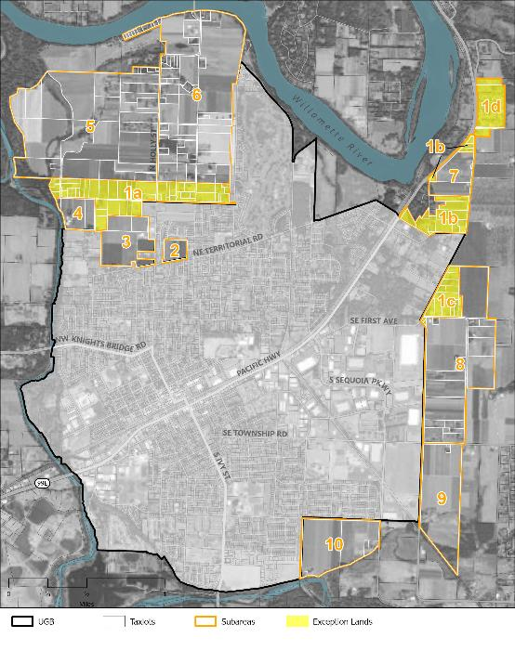
Priority #1: Exception Lands
Subareas 1a, 1b, 1c, 1d

Slide 14

Subarea 1a
115.9 gross acres; No constrained acres
Exception land/1st priority for UGB expansion
Suitable for residential use
Can accommodate entire residential land need
Recommendation: Include 73.1 acres for residential use.
Recommendation: Include 25.7 acres for park use.

Slide 15
Subarea 1b
1b: 50.0 gross acres; 7.7 constrained acres (Willamette River Greenway, Slope > 10%)
Exception land/1st priority for UGB expansion
Suitable for residential or employment uses, but entire residential need is accommodated in Subarea 1a
Recommendation: Include Subarea 1b (50.0 acres) to the UGB, including 42.3 unconstrained acres to accommodate a portion of the employment land deficit. Subarea 1b could also include parks.

Slide 16
Subarea 1c
1c: 34.3 gross acres; No constrained acres
Exception land/1st priority for UGB expansion
Suitable for residential or employment uses, but entire residential need is accommodated in Subarea 1a
Recommendation: Include Subarea 1c (34.3 unconstrained acres) to the UGB to accommodate a portion of the employment land deficit. Subarea 1c could also include parks.

Slide 17
Subarea 1d
39.0 gross acres; 9.1 constrained acres (Historic Landmark, Slopes > 10%, Cemetery, Title III Wetland)
Exception land/1st priority for UGB expansion
Built out with manufactured home park and cemetery
Suitable for residential use, but entire residential need is accommodated in Subarea 1a
Recommendation: Do not include any land from Subarea 1d into the UGB.

Slide 18
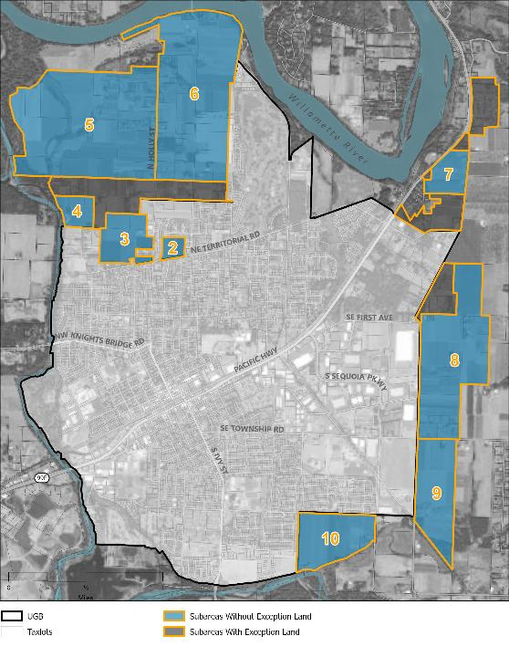
Priority #4: High-Value Farmland
Subareas 2-10

Slide 19
Subarea 2
13.0 gross acres; no constrained acres
4th (next) priority for UGB expansion
Suitable for residential use, but cannot be included if entire residential need is accommodated in Subarea 1a
Recommendation: Consider adding Subarea 2 to the UGB through a Goal 3, 11, and 14 irrevocable committed exception process at a future date.

Slide 20
Subarea 3
60.8 gross acres; no constrained acres
4th (next) priority for UGB expansion
Suitable for residential use , but cannot be included if entire residential need is accommodated in Subarea 1a
Recommendation: Consider adding Subarea 3 to the UGB as part of a future amendment through goal exception or standard Goal 14 analysis.

Slide 21
Subarea 4
27.8 gross acres; 0.01 constrained acres (100-year floodplain)
4th (next) priority for UGB expansion
Suitable for residential use
Swan Island Dahlia Farm is an important social, cultural, and economic institution
Recommendation: Do not include any land from Subarea 4 into the Canby UGB.

Slide 22
Subarea 5
392.5 acres; 186.2 constrained acres (Willamette River Greenway, 100-year floodplain, Title III Wetland)
4th (next) priority for UGB expansion
Suitable for residential use , but cannot be included if entire residential need is accommodated in Subarea 1a
Recommendation: Do not include any land from Subarea 5 into the Canby UGB.

Slide 23
Subarea 6
345.8 acres; 52.9 constrained acres (Slopes > 10%, 100-Year Floodplain, Title III Wetland, Willamette River Greenway)
4th (next) priority for UGB expansion
Suitable for residential use , but cannot be included if entire residential need is accommodated in Subarea 1a
Recommendation: Do not include any land from Subarea 6 into the Canby UGB.

Slide 24
Subarea 7
40.5 acres; 1.8 constrained acres (Slope > 10%)
4th (next) priority for UGB expansion
Suitable for residential or employment uses
Adjacent to Subarea 1b
Recommendation: Include Subarea 7 (40.5 acres) to the UGB, including 38.7 unconstrained acres to accommodate a portion of the employment land deficit. Subarea 7 could also include parks.

Slide 25
Subarea 8
227.9 acres; 14.5 constrained acres (Historic Landmark, Slope > 10%)
4th (next) priority for UGB expansion
Suitable for employment uses
Recommendation: Include subarea 8 (227.9 acres) to the UGB, including 213.5 unconstrained acres to accommodate a portion of the employment land deficit. Subarea 8 could also include parks.

Slide 26
Subarea 9
112.0 acres; 43.1 constrained acres (Goal 5 Stream Buffer, 100-Year Floodplain)
4th (next) priority for UGB expansion
Suitable for employment uses
Recommendation: Include the northern portion of Subarea 9 (60.8 acres) to the UGB to accommodate a portion of the employment land deficit. Subarea 9 could also include parks.

Slide 27
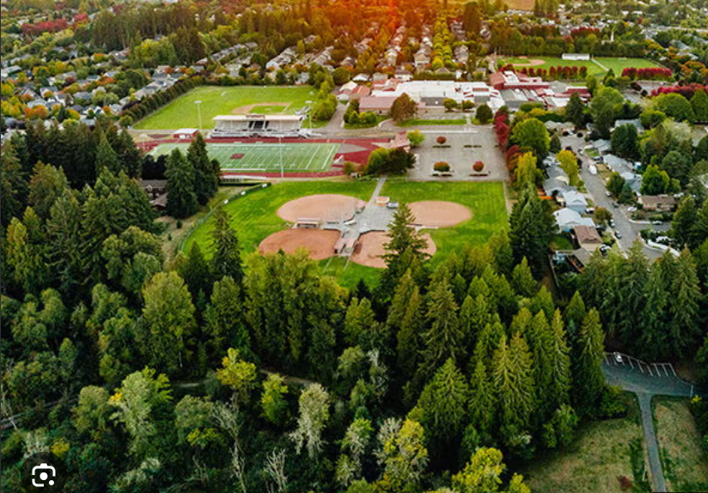
Subareas 8 & 9
Potential locations for a sports complex
Canby EOA identifies up to 35 acres for a sports complex
Parks are an allowed use in Industrial zones
Sports complex use and location will be determined through the Concept Plan process

Slide 28
Subarea 10
95.9 acres; 1.1 constrained acres (Slope > 10%, 100-Year Floodplain)
4th (next) priority for UGB expansion
Suitable for residential or employment uses, but entire residential need is accommodated in Subarea 1a
Recommendation: Do not include any land from Subarea 10 into the Canby UGB at this time as it may be better suited for future residential use.

Slide 29
UGB Recommendation
Total 20-year land need = up to 538.0 acres
UGB amendment recommendation = up to 512.3 gross acres / 488.4 unconstrained acres
Subarea | Gross Acres | Gross UGB Acres | Unconstrained Residential Acres | Unconstrained Park Acres | Unconstrained Employment Acres | Total Unconstrained Acres
1a | 115.9 | 98.8 | 73.1 | 25.7 |  | 98.8
1b | 50.0 | 50.0 |  |  | 42.3 | 42.3
1c | 34.3 | 34.3 |  |  | 34.3 | 34.3
1d | 39.0
2 | 13.0
3 | 60.8
4 | 27.8
5 | 392.5
6 | 345.8
7 | 40.5 | 40.5 |  |  | 38.7 | 38.7
8 | 227.9 | 227.9 |  |  | 213.5 | 213.5
9 | 112.0 | 60.8 |  |  | 60.8 | 60.8
10 | 95.9
TOTAL | 1,555.4 | 512.3 | 73.1 | 25.7 | 389.6 | 488.4

Slide 30
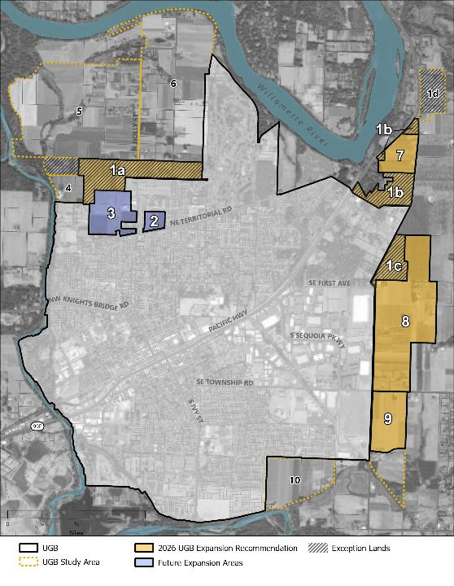
UGB Recommendation
Recommend for Current UGB Expansion
Subareas 1a (partial), 1b, 1c, 7, 8, 9 (partial)
Not Recommended for UGB Expansion
Subareas 1d, 2, 3, 4, 5, 6, 10

Slide 31
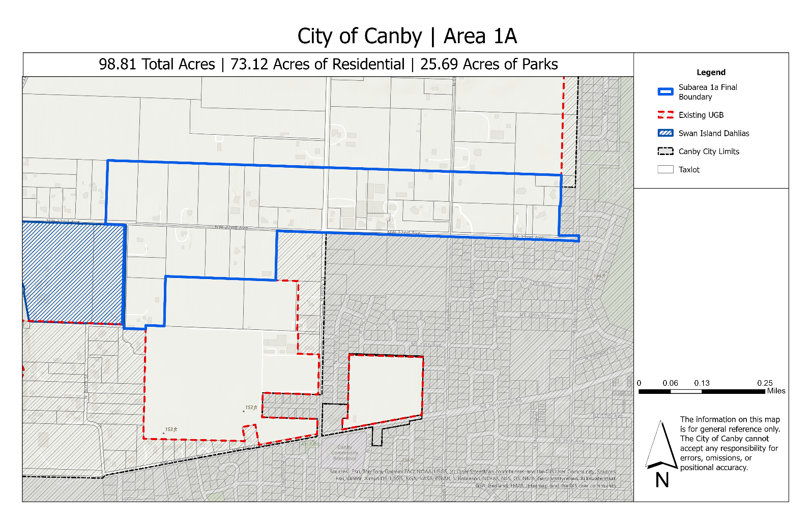
Subarea 1a Proposed Boundary

Slide 32


Thank you!

